Slide 1
Mediation and Moderation
Vanessa LoBue
Jamil Bhanji
with a little help from Andy Field

Slide 2
Moderation
The combined effect of two variables on another is known conceptually as moderation, and in statistical terms as an interaction effect.

Slide 3
Example
Do violent video games make people antisocial?
Participants
442 youths
Outcome
Aggression,
Callous unemotional traits (CaUnTs)
Number of hours spent playing video games per week

Slide 4
Conceptual Moderation Model
If callous-unemotional traits were a moderator then we’re saying that the strength or direction of the relationship between game playing and aggression is affected by callous-unemotional traits.

Slide 6
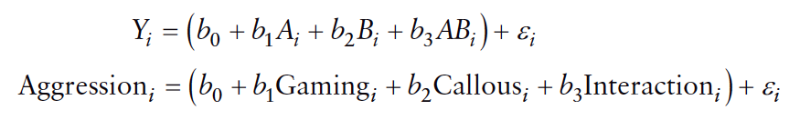
The Statistical Moderation Model

Slide 7
Centering Variables
The interaction term makes the bs for the main predictors uninterpretable in many situations.
For this reason, it is common to transform the predictors using grand mean centring.
Centring refers to the process of transforming a variable into deviations around a fixed point.

Slide 8
Fitting the model

Slide 9
Output
************************************************************************** Model = 1 Y = Aggress X = Vid_Game M = CaUnTs Sample size 442 ************************************************************************** Outcome: Aggress Model Summary R R-sq MSE F df1 df2 p .6142 .3773 99.5266 90.5311 3.0000 438.0000 .0000 Model coeff se t p LLCI ULCI constant 39.9671 .4750 84.1365 .0000 39.0335 40.9007 CaUnTs .7601 .0466 16.3042 .0000 .6685 .8517 Vid_Game .1696 .0759 2.2343 .0260 .0204 .3188 int_1 .0271 .0073 3.7051 .0002 .0127 .0414 Interactions: int_1 Vid_Game X CaUnTs

Slide 10
Output
Conditional effect of X on Y at values of the moderator(s): CaUnTs Effect se t p LLCI ULCI -9.6177 -.0907 .1058 -.8568 .3920 -.2986 .1173 .0000 .1696 .0759 2.2343 .0260 .0204 .3188 9.6177 .4299 .1010 4.2562 .0000 .2314 .6284 Values for quantitative moderators are the mean and plus/minus one SD from mean. Values for dichotomous moderators are the two values of the moderator.

Slide 11
Output

Slide 12
Following up moderation with simple slopes analysis

Slide 13
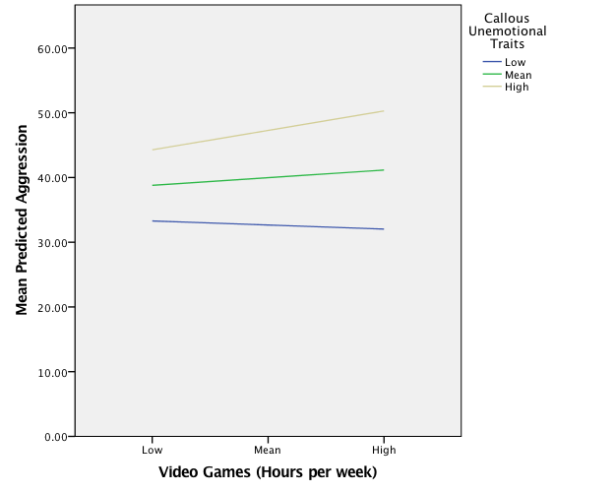

Slide 14
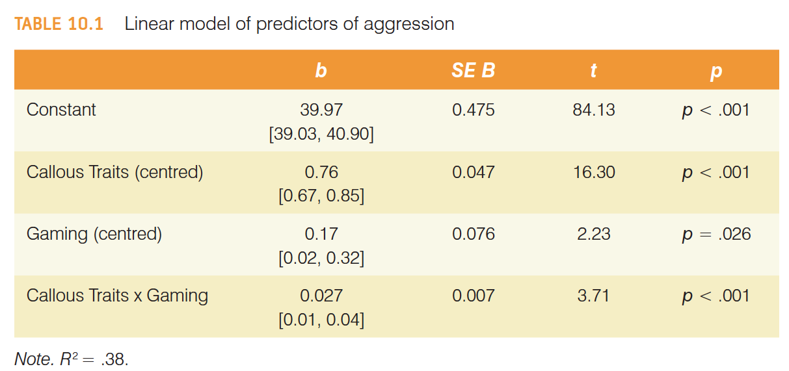
Reporting Moderation Analysis

Slide 15
Mediation
Refers to a situation when the relationship between a predictor variable and outcome variable can be explained by their relationship to a third variable (the mediator).

Slide 16
The Statistical Model

Slide 17
Baron & Kenny, (1986)
Mediation is tested through three regression models:
Predicting the outcome from the predictor variable.
Predicting the mediator from the predictor variable.
Predicting the outcome from both the predictor variable and the mediator.

Slide 18
Baron & Kenny, (1986)
Four conditions of mediation:
The predictor must significantly predict the outcome variable.
The predictor must significantly predict the mediator.
The mediator must significantly predict the outcome variable.
The predictor variable must predict the outcome variable less strongly in model 3 than in model 1.

Slide 19
Limitations of Baron & Kenny’s (1986) approach
How much of a reduction in the relationship between the predictor and outcome is necessary to infer mediation?
people tend to look for a change in significance, which can lead to the ‘all or nothing’ thinking that p-values encourage.

Slide 20
Sobel Test (Sobel, 1982)
An alternative is to estimate the indirect effect and its significance using the Sobel test (Sobel. 1982).
If the Sobel test is significant, there is significant mediation.
Significance tests depend upon sample size.

Slide 21



Effect Sizes of Mediation

Slide 22



Effect Sizes of Mediation II

Slide 23
Example of a Mediation Model

Slide 24
Fitting the Model

Slide 25
Output
************************************************************************** Model = 4 Y = Phys_Inf X = LnPorn M = Commit Sample size 239 ************************************************************************** Outcome: Commit Model Summary R R-sq MSE F df1 df2 p .1418 .0201 .5354 4.8633 1.0000 237.0000 .0284 Model coeff se t p LLCI ULCI constant 4.2027 .0545 77.1777 .0000 4.0954 4.3100 LnPorn -.4697 .2130 -2.2053 .0284 -.8892 -.0501

Slide 26
Output
************************************************************************** Outcome: Phys_Inf Model Summary R R-sq MSE F df1 df2 p .3383 .1144 .4379 15.2453 2.0000 236.0000 .0000 Model coeff se t p LLCI ULCI constant 1.3704 .2518 5.4433 .0000 .8744 1.8663 Commit -.2710 .0587 -4.6128 .0000 -.3867 -.1552 LnPorn .4573 .1946 2.3505 .0196 .0740 .8407

Slide 27
Output
************************** TOTAL EFFECT MODEL **************************** Outcome: Phys_Inf Model Summary R R-sq MSE F df1 df2 p .1859 .0346 .4754 8.4866 1.0000 237.0000 .0039 Model coeff se t p LLCI ULCI constant .2315 .0513 4.5123 .0000 .1304 .3326 LnPorn .5846 .2007 2.9132 .0039 .1893 .9800

Slide 28
***************** TOTAL, DIRECT, AND INDIRECT EFFECTS ******************** Total effect of X on Y Effect SE t p LLCI ULCI .5846 .2007 2.9132 .0039 .1893 .9800 Direct effect of X on Y Effect SE t p LLCI ULCI .4573 .1946 2.3505 .0196 .0740 .8407 Indirect effect of X on Y Effect Boot SE BootLLCI BootULCI Commit .1273 .0708 .0170 .2972 Partially standardized indirect effect of X on Y Effect Boot SE BootLLCI BootULCI Commit .1818 .0997 .0215 .4156 Completely standardized indirect effect of X on Y Effect Boot SE BootLLCI BootULCI Commit .0405 .0220 .0052 .0922 Ratio of indirect to total effect of X on Y Effect Boot SE BootLLCI BootULCI Commit .2177 8.6658 .0082 1.2609 Ratio of indirect to direct effect of X on Y Effect Boot SE BootLLCI BootULCI Commit .2783 13.7610 -.0392 4.1073 R-squared mediation effect size (R-sq_med) Effect Boot SE BootLLCI BootULCI Commit .0138 .0104 .0009 .0462

Slide 29
Sobel test
Normal theory tests for indirect effect Effect se Z p .1273 .0652 1.9526 .0509

Slide 30
Reporting Mediation Analysis
There was a significant indirect effect of pornography consumption on infidelity though relationship commitment, b = 0.127, 95% BCa CI [0.017, 0.297].

Slide 31
Reporting Mediation Analysis

Slide 32
Categorical Predictors in Regression
Often you will have categorical predictors that have more than two categories
These groups cannot be distinguished using a single variable coded with zeros and ones. Therefore, we use what’s called dummy variables

Slide 33
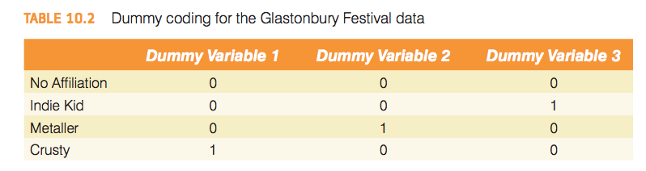
Dummy coding for the Glastonbury Festival Data

Slide 34
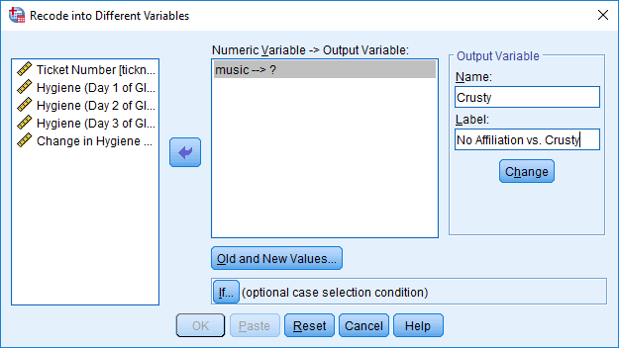

Slide 35
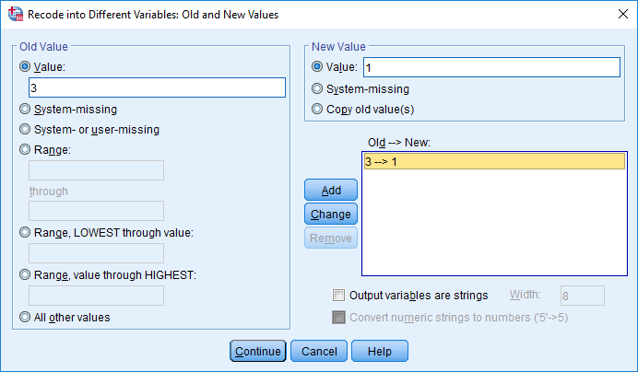

Slide 36
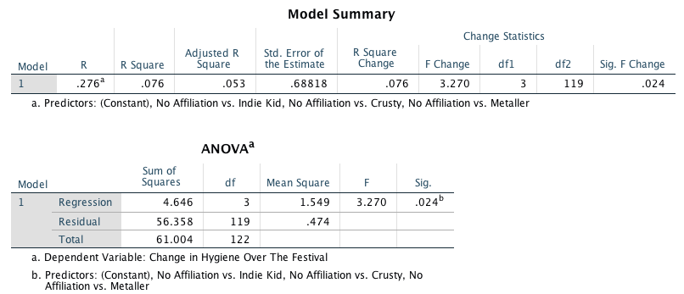
Output for Dummy Variables

Slide 37
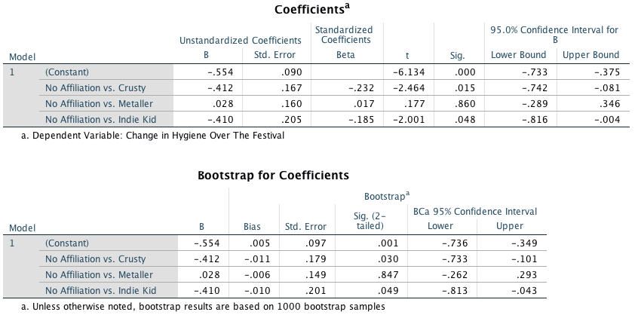
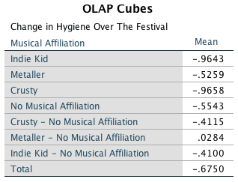

Slide 38
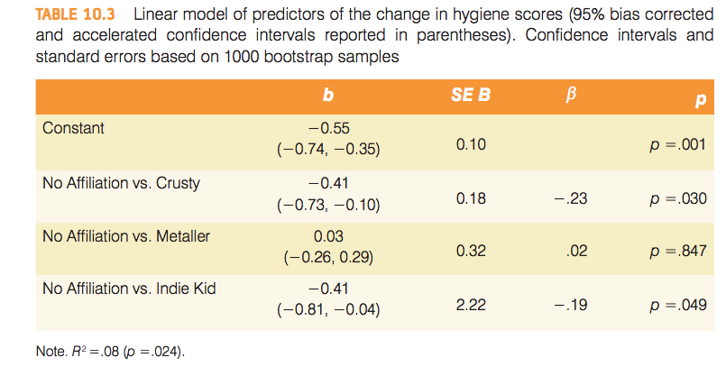
Reporting Results

